Slide 1
LIGHTNING TALK #2
Automobile Loan
Default Prediction
EDA, Cleaning & Modeling Plan — Credit Risk Classification
Sayed Ali Mahmood Ali • DSB2

Slide 2
Problem Statement & Success Metrics
!
Manual loan underwriting is slow and inconsistent — lenders must weigh dozens of applicant attributes to judge default risk, and with only 8.1% of applicants defaulting, missing a true defaulter is far costlier than flagging a safe applicant for review.
$
We aim to classify applicants as “high risk” or “low risk” of default at time of application — using financial, demographic, and credit-bureau data — so loan officers can flag risky applications before funds are disbursed.
SUCCESS METRICS:
Recall on the Default class • PR-AUC & F1 over accuracy given the 8.1% imbalance • Precision monitored to keep the manual-review queue manageable
2

Slide 3
Potential Audience
PRIMARY USERS
WHY THEY CARE
Reduces reliance on manual, inconsistent underwriting judgment
Lenders & Loan Officers
A credit-risk decision tool used at the point of application — helping underwriters decide whether to approve a loan or flag it for closer manual review, before funds are disbursed.
Surfaces high-risk applicants earlier — before funds are disbursed
Lets the review team focus effort only on flagged, high-risk cases
Secondary: risk & retention teams who benefit from earlier, more accurate visibility into which applicants carry elevated default risk.
A missed defaulter is far costlier than a false alarm — recall matters most to this audience
3

Slide 4
Goals & Objectives
1
Clean & validate the data
Resolve placeholders, outliers, and missingness with evidence-based decisions (MNAR checks, chi-square, target-balance validation) — not default conventions.
2
Quantify signal via EDA
Confirm which features actually associate with Default before modeling, using correlation and chi-square testing rather than assumption.
3
Build a recall-first classifier
Train and compare models optimized to catch true defaulters, evaluated against a majority-class baseline rather than raw accuracy.
4
Deliver an actionable risk flag
Produce a model output loan officers can use directly to prioritize manual review, not just a lab metric.
4

Slide 5
Model Type & Planned Models
Binary Classification
Target: Default (0 = No Default, 1 = Default) • 3 models planned
1
2
3
Logistic Regression
Random Forest
Gradient Boosting (XGBoost)
Interpretable baseline — coefficients show which features raise or lower risk
Captures non-linear feature interactions; provides feature importance
Primary candidate — typically strongest on tabular data of this kind
5

Slide 6
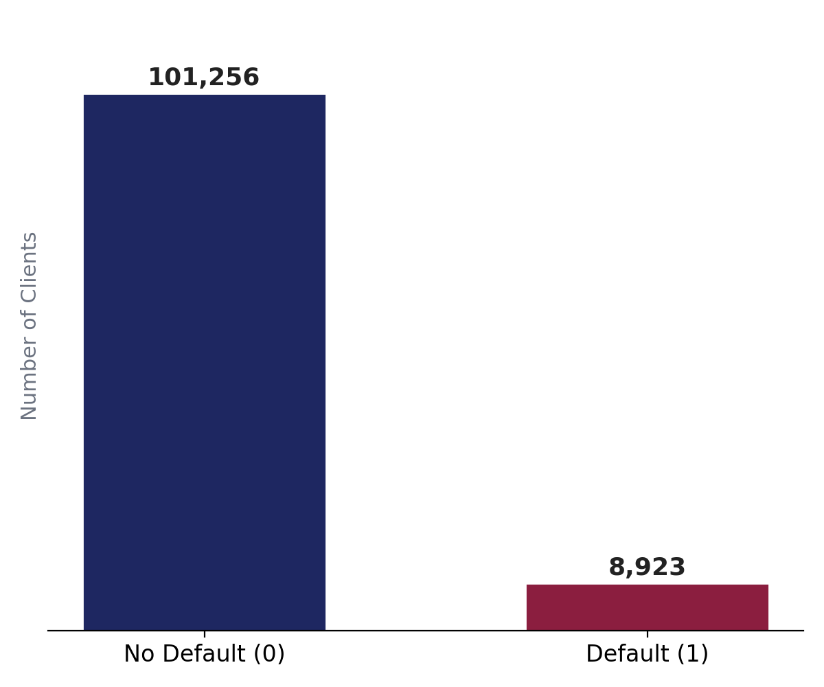
Evaluation Metrics
Recall (primary)
Catch as many true defaulters as possible — missing one is costlier than a false alarm.
PR-AUC & F1
More informative than accuracy or ROC-AUC given the ~8% class imbalance.
Precision
Tracked to keep the false-positive rate — and the review queue — manageable.
Baseline to beat
Majority-class predictor: 0% recall at 92% accuracy.
8.1% of applicants default — accuracy alone would reward a model that flags no one.
6

Slide 7
About the Data — Overview
110,179
35
8.1%
Kaggle
Rows after cleaning (from 121,856)
Columns (post cleaning)
Default rate (target)
Automobile / consumer loan data
DATA DICTIONARY — 35 FEATURES ACROSS 6 GROUPS
Financial (3)
Assets & Obligations (6)
Demographic (7)
Client_Income, Credit_Amount, Loan_Annuity
Car/Bike/House_Own, Active_Loan, Child_Count, Family_Members
Education, Marital Status, Gender, Housing, Age, City Rating, Region
Employment (6)
Identity & Contact (7)
Bureau & Risk (5)
Income Type, Occupation, Organization, Employed_Days, Accompany, Contract Type
Registration/ID_Days, Mobile/Home/Work phone tags, address-match tags
Score_Source_1/2/3, Social_Circle_Default, Credit_Bureau
7

Slide 8
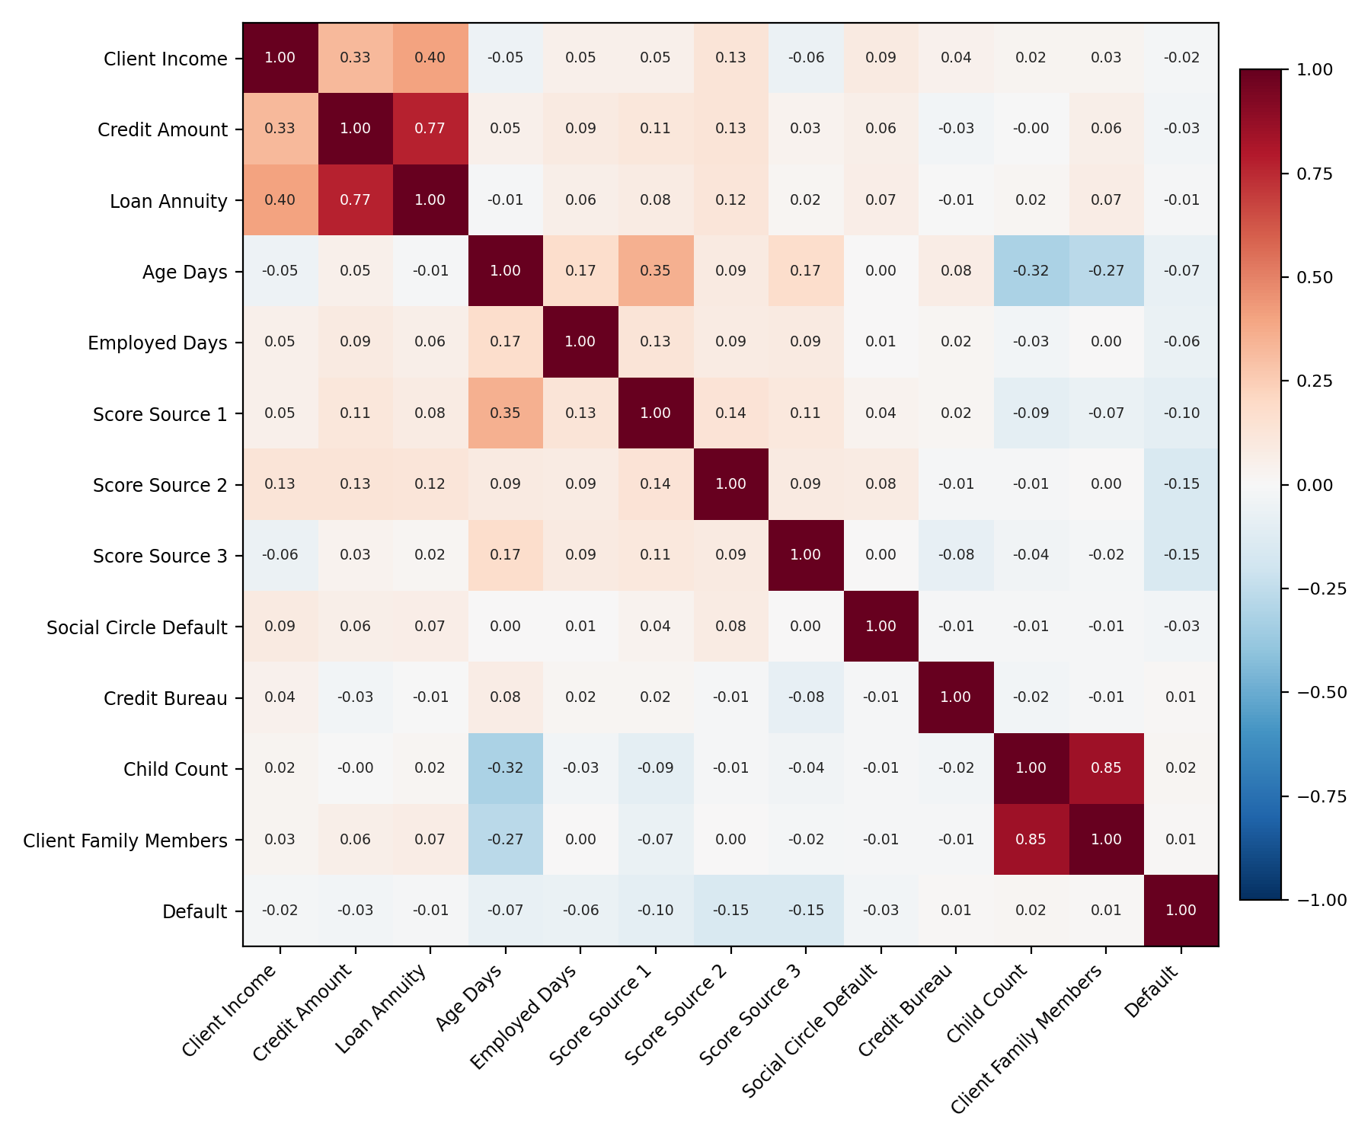
About the Data — EDA for Modeling
CORRELATION — TOP PREDICTORS
-0.151
Score_Source_3
-0.151
Score_Source_2
-0.095
Score_Source_1
-0.074
Age_Days
CHI-SQUARE — CATEGORICAL FEATURES
All 8 categorical features tested show a statistically significant association with Default (p < 0.05). Strongest: Client_Occupation (χ² = 655.5, p = 1.5e-127) and Type_Organization (χ² = 637.2, p = 5.5e-99) — both tied to employment status.
Watch: Child_Count - Client_Family_Members r = 0.85 (multicollinearity to address in preprocessing)
8

Slide 9
Progress Report — Challenges
OPEN ISSUES
Client_Income outlier (1,800,009)
2.7× the next-highest value; still needs a final treatment decision (cap, flag, or leave with stated justification) before modeling.
34 cleaning judgment calls made
Each decision (drop vs. impute, median vs. mode, need to be confirmed if it’s the best.
High-cardinality columns
Occupation and Organization Type still need a finalized encoding strategy to avoid excessive one-hot dimensionality.
Modest effect sizes
No single feature is strongly predictive (top correlation ≈ -0.15) — performance will depend on combining many weak-to-moderate signals.
9

Slide 10
Progress Report — Next Steps
PLANNED WORK
1
Finalize the Client_Income outlier treatment
2
Execute encoding, scaling, and engineered features (Credit_Income_Ratio, Annuity_Income_Ratio)
3
Address class imbalance — class_weight='balanced' and/or SMOTE on the training set only
4
Train the 3 planned models on a stratified train/test split
5
Tune for recall / PR-AUC and finalize feature importance for the capstone report
10

Slide 11
Thank You
Questions & Discussion
11

